Slide 1

Transdisciplinary Project
Topic :-Impact of Virtual Reality on Learning and Cognitive Development
BY: AYUSHI SHARMA(23MGT2BBB155)
SHIVANSHU SINGH(23LAW2BB017)
AYUSH VYAS(23CSA2BC058)
AMIT SINGH(23TEC2CS201)

Slide 2

Project Objective
The primary objective of this research is to investigate the impact of VR on learning and cognitive development. Specifically, we aim to explore how VR experiences influence learning outcomes, enhance cognitive skills like spatial reasoning, problem-solving, and memory, and promote engagement and motivation in educational settings.
1
Understand the effects of VR on learning outcomes
2
Examine the impact of VR on cognitive skills
Evaluate the effectiveness of VR-based learning compared to traditional methods in terms of knowledge retention, skill acquisition, and overall academic performance.
Investigate how VR experiences influence spatial reasoning, problem-solving abilities, memory capacity, and other cognitive functions.
3
Explore the role of VR in promoting engagement and motivation
4
Identify potential benefits and limitations of VR in education
Assess how VR environments can enhance learner engagement, increase motivation, and foster a more positive learning experience.
Analyze the advantages and challenges associated with integrating VR into educational settings, considering factors such as accessibility, cost, and pedagogical considerations.

Slide 3
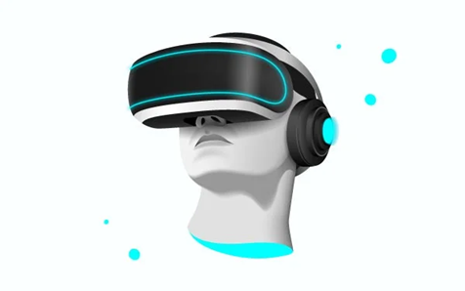
Research Questions
To guide our investigation, the following research questions will be addressed:
DO YOU FIND VITUAL LEARNING MORE ENGAGING THAN TRADITIONAL IN-PERSON LEARNING ?
IN YOUR EXPERIENCE DOES VITUAL LEARNING IMPACT YOUR FOCUS AND CONCENTRATION ?
DO YOU FEEL THAT VITUAL LEARNING CITICAL THINKING ABILITIES ?
WHAT ARE THE MAIN CHALLENGES YOU WITH VITULA LEARNING ?
WHAT BENEFITS HAVE YOU EXPERIENCED WITH VITUAL LEARNING ?
On a scale of 1-10, how would you rate the impact of virtual learning on your cognitive development?
Do you believe virtual learning should be incorporated alongside traditional methods in the future?
HOW OFTEN DO YOU USE VIRTUAL LEARNING PLATFORM ?
WHCIH VITUAL LEARNING PLATFROM(S) DO YOU PRIMARILY USE ?
HOW MUCH TIME DO YOU SPEND ON VITUAL LEARNING EACH DAY ?

Slide 4
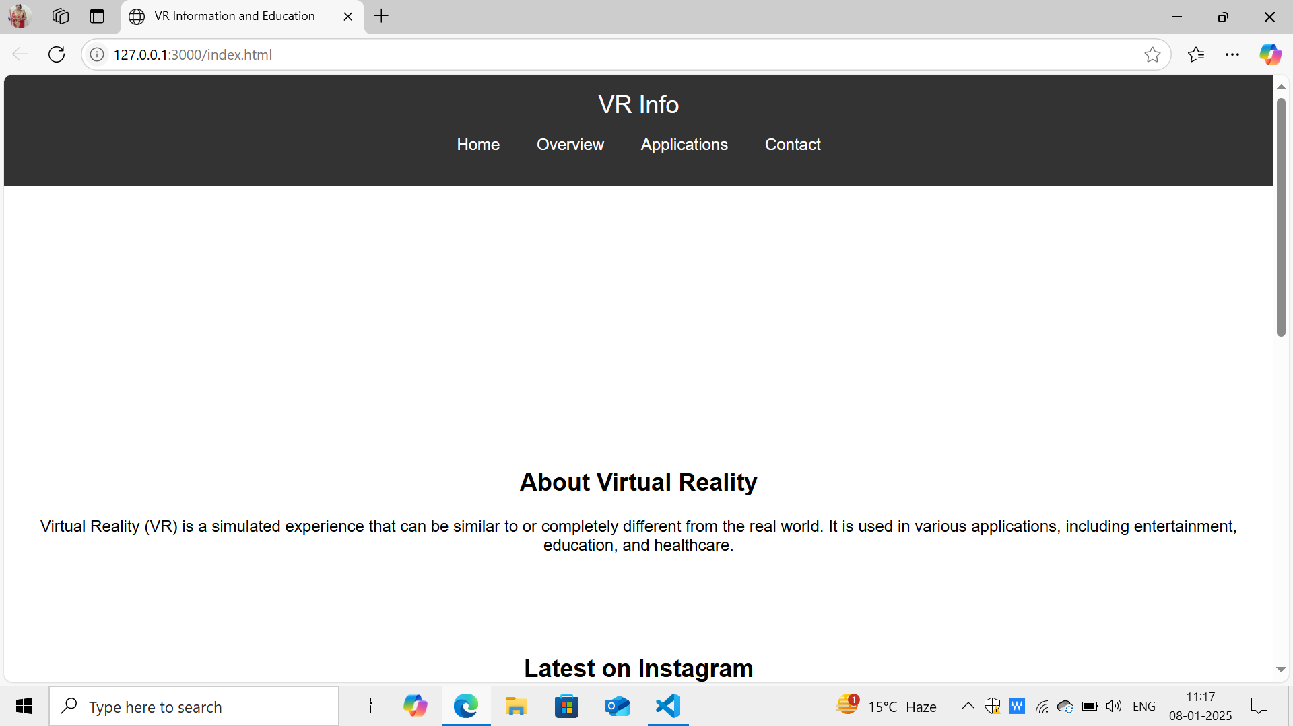
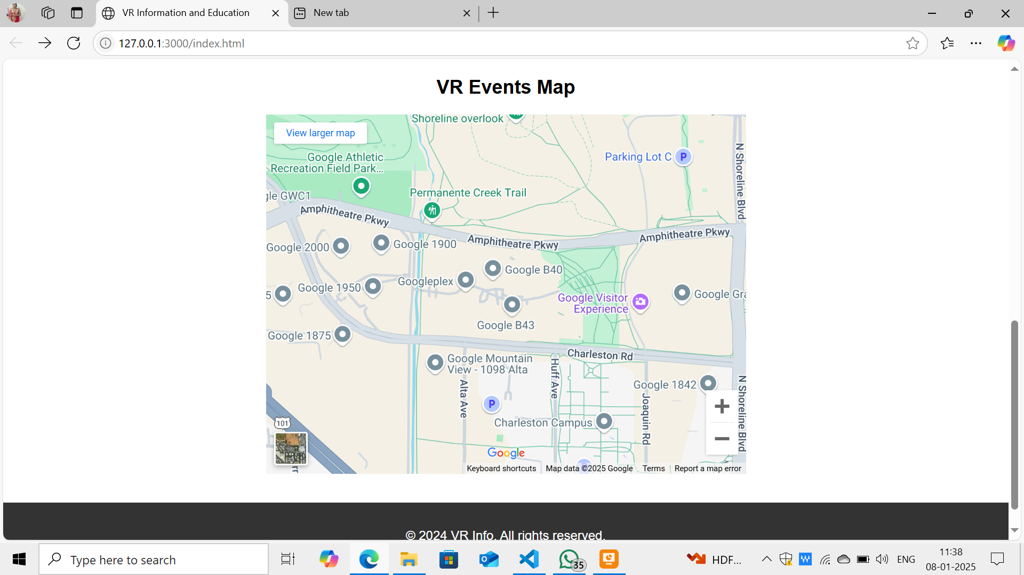
OUR WEBSITE

Slide 5

Literature Review
An extensive literature review will be conducted to gain a comprehensive understanding of the existing body of research on VR and its impact on learning and cognitive development. This review will focus on studies investigating the effectiveness of VR-based learning, the effects of VR on cognitive skills, and the role of VR in promoting engagement and motivation in education.
PAPERS:
Effectiveness of virtual reality on learning Engagement : A Meta analysis (JINKU WANG)
Included a flowchart of the study selection process in methods along with statistical analysis and data synthesis methods
2. Effects of virtual reality learning environment on student cognitive and linguistic development (YU-LI CHEN)
Did experimentation and also the result and impacts of it were discussed. Had even told a model named structural equation modeling analysis.

Slide 6


Methodology
This research will employ a mixed-methods approach to collect and analyze data related to the impact of VR on learning and cognitive development.
Quantitative Data
Qualitative Data
Data Analysis
Quantitative data will be collected through pre- and post-tests, surveys, and performance assessments to measure the effectiveness of VR-based learning, cognitive skills, and learner engagement.
Qualitative data will be gathered through interviews, focus groups, and observations to understand the subjective experiences of learners, their perceptions of VR, and their perspectives on the benefits and challenges of VR in education.
Quantitative data will be analyzed using statistical techniques to identify significant differences in learning outcomes, cognitive skills, and engagement levels between VR and traditional learning methods.

Slide 7
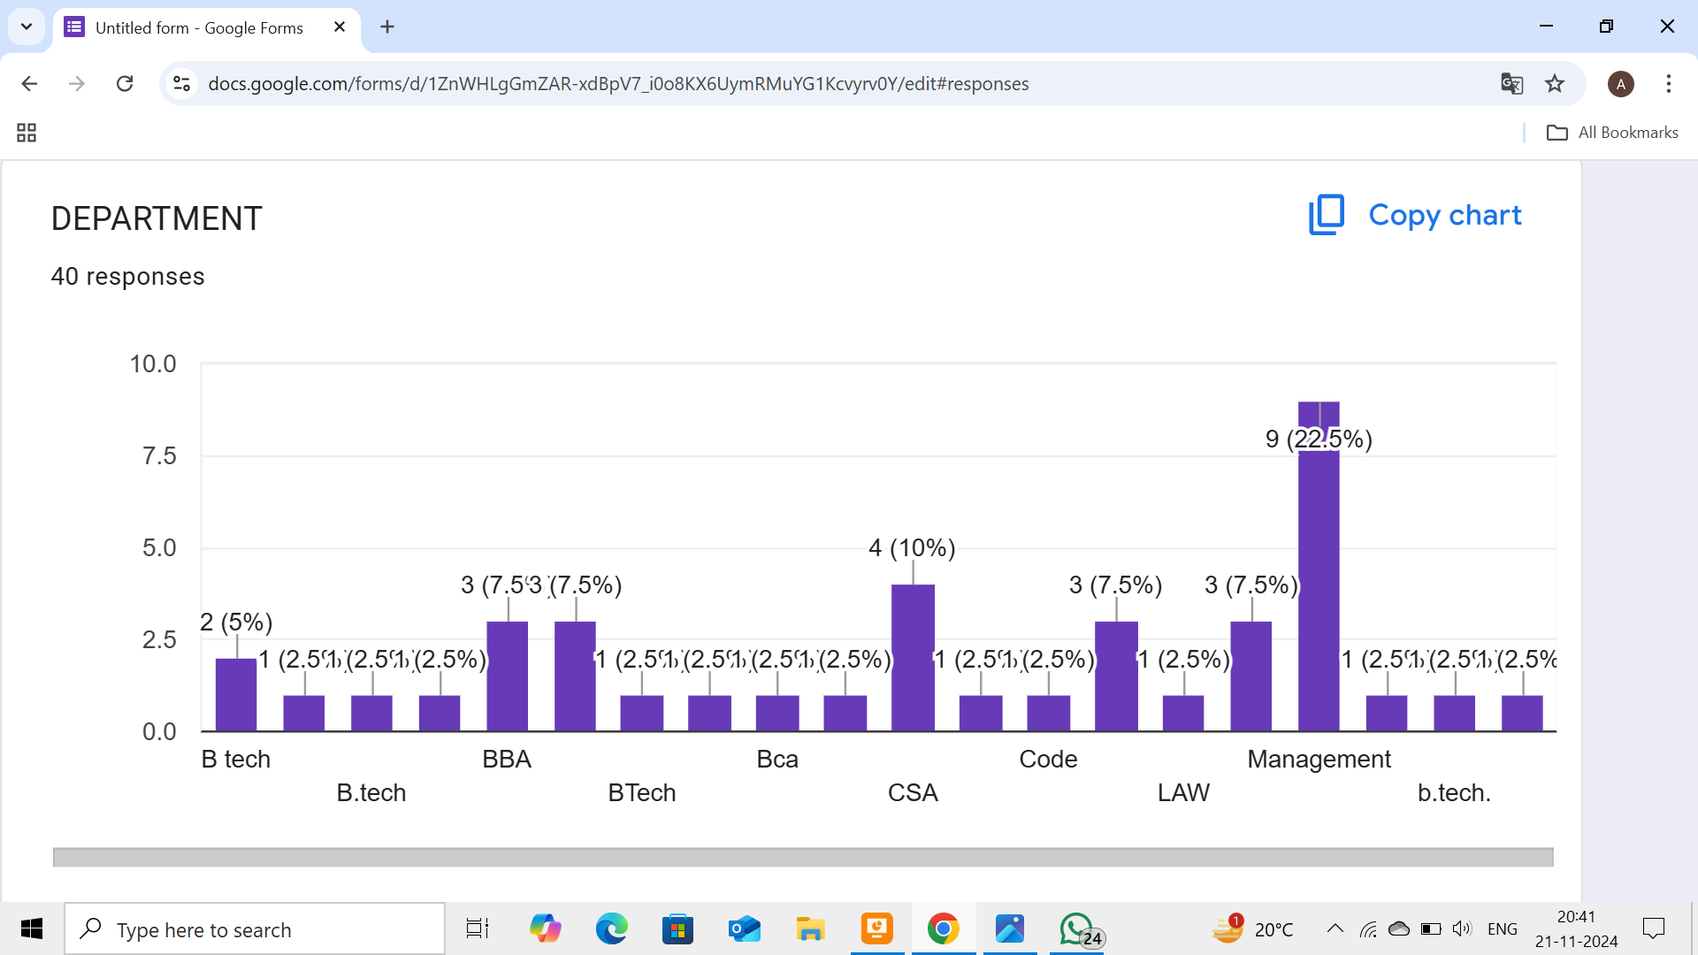
700 Responses

Slide 8

Data Collection and Analysis
Participants will be recruited from a diverse pool of learners across different age groups and educational levels. They will be randomly assigned to either a VR-based learning group or a traditional learning group. Both groups will receive instruction on the same subject matter, but the VR group will experience the content through immersive VR simulations, while the traditional group will receive instruction through traditional methods.
Data will be collected at baseline, after the VR intervention, and at follow-up intervals to assess the long-term effects of VR on learning and cognitive skills.

Slide 9
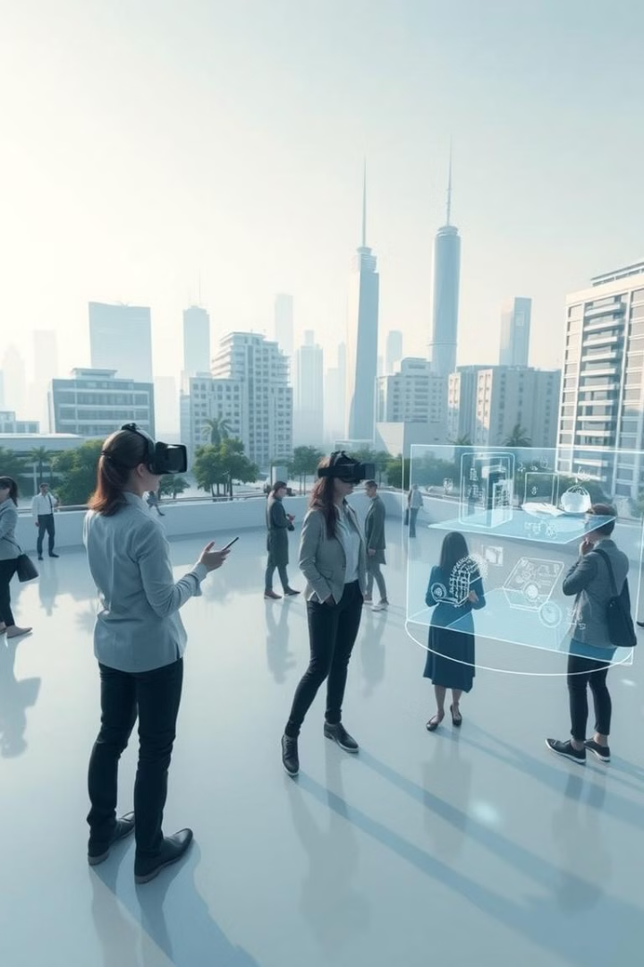
Expected Outcomes
This research is expected to yield valuable insights into the impact of VR on learning and cognitive development. We anticipate finding evidence to support the claim that VR-based learning can enhance learning outcomes, improve cognitive skills, and foster greater engagement and motivation in educational settings.
The findings of this research will contribute to the growing body of literature on VR and education, providing valuable information for educators, researchers, and policymakers interested in exploring the potential of VR for transformative learning experiences.

Slide 10
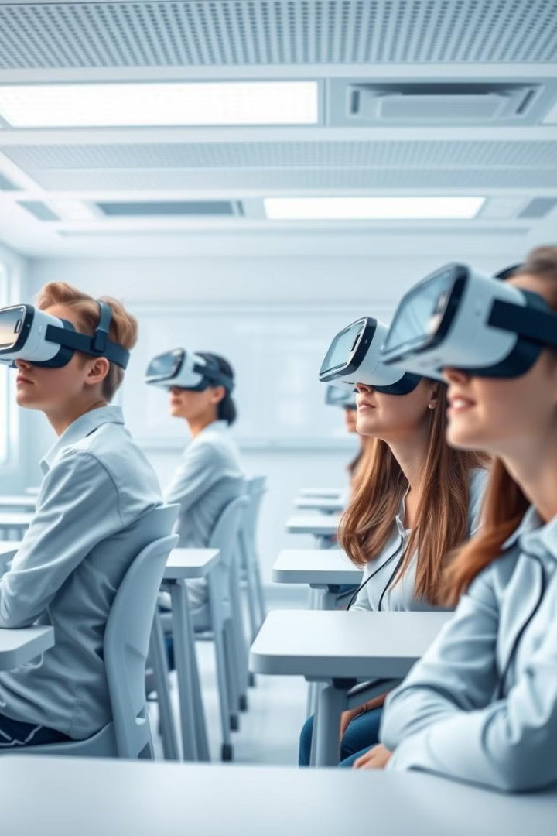
Conclusion and Future Directions
The conclusion of this research will synthesize the findings and provide a comprehensive analysis of the impact of VR on learning and cognitive development. This analysis will highlight the significant potential of VR to enhance learning outcomes, improve cognitive skills, and promote engagement and motivation in educational settings.
Future research directions will explore the long-term effects of VR on learning and cognitive development, investigate the effectiveness of VR in different subject areas and educational contexts, and examine the impact of VR on learners with diverse needs and learning styles.

